Slide 1
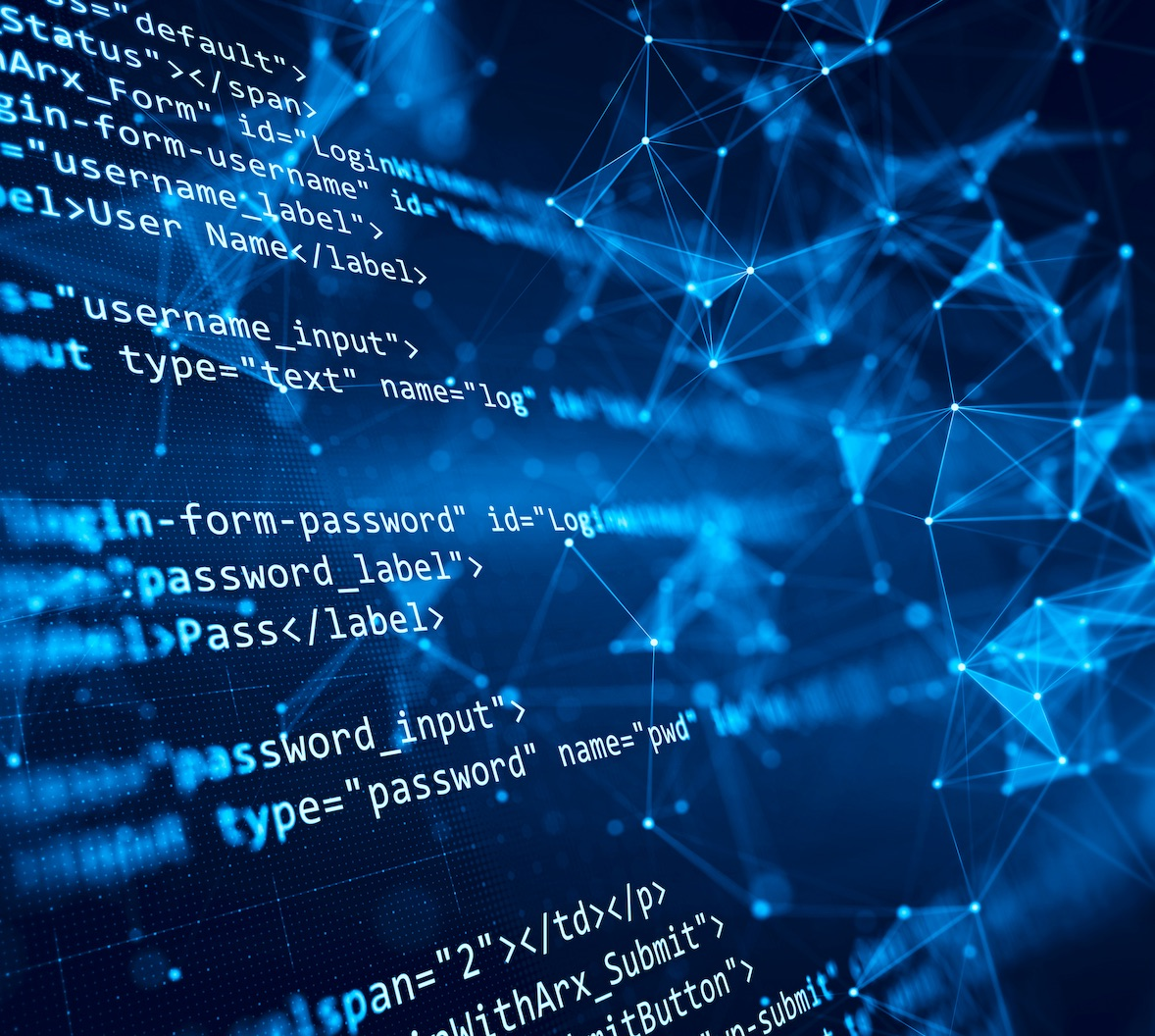

Team 55: Research Lab
Inventory Tracker
Bi-Weekly Update 2 Lizzett Tapia Sumedha Bhattacharyaa Jonathan Moore Evan Ross TA: Niloofar Borzooei
Notes:
Michelle

Slide 2
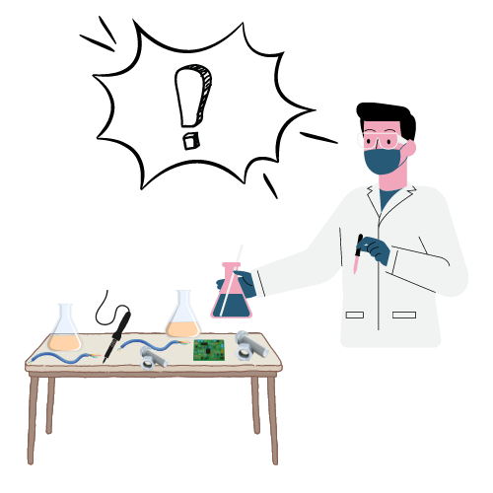
Problem Statement
“The current lab inventory tracking systems at Texas A&M are inefficient, and it is necessary to create new, organized software to increase the overall performance and efficiency of the Lab.”

Slide 3
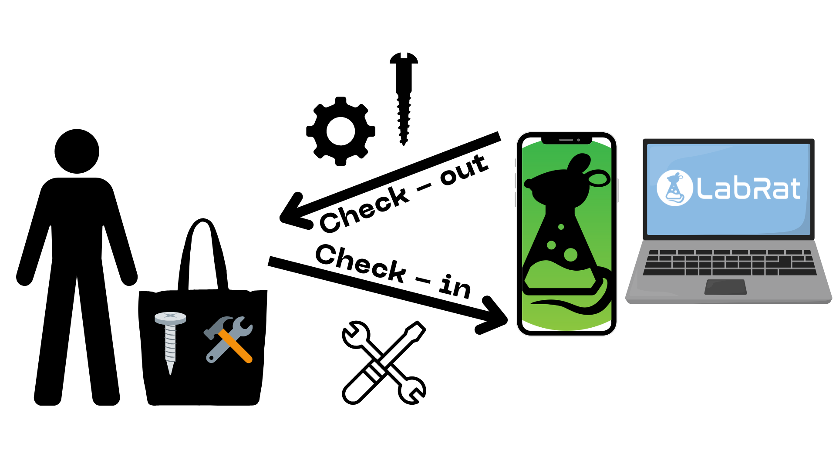
Solution Proposal
“Develop a web and mobile application integrated with a database to streamline inventory management in TAMU labs. The mobile app uses a machine learning-based image classification system to allow users to easily check items in and out by scanning them.”

Slide 4
Interaction of Subsystems
Database
Web-App
Mobile App
Machine Learning Model
Jonathan Lizzett Sumedha Evan

Slide 5
Project Timeline
Subsystem Designs and Testing (completed 1/27) | Integration preparation of server with website and mobile app (completed 2/3) | Integration of ML model with mobile application (to complete by 2/17) | Final Integration (to complete by 3/3) | System Test (to complete by 3/24) | Validation (to complete by 4/14) | Demo and Report (to complete by 4/21 and 4/28 respectively)

Slide 6
Android App
Evan Ross
Accomplishments since last update 12 hrs of effort | Ongoing progress/problems and plans until the next presentation
Local database tables and app functionality better aligned with website and database. Connected to external database Began experimenting with flask and backend | Finalize connection to external database Begin connection to backend and ML model

Slide 7
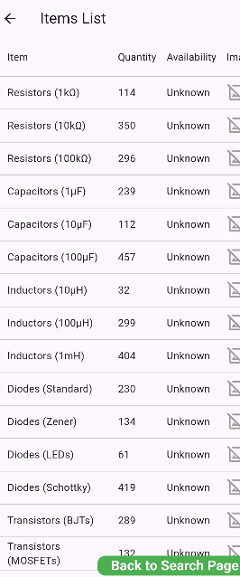
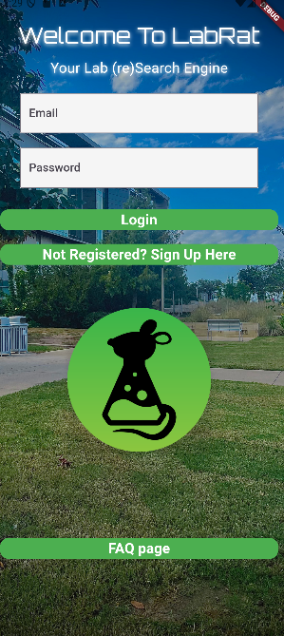
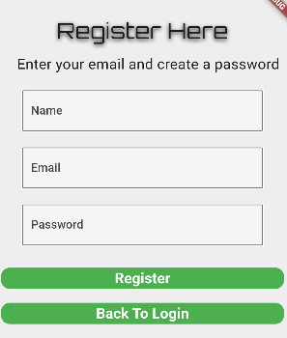
Android App
Evan Ross

Slide 8
Website
Jonathan
Accomplishments since last update 12 hrs of effort | Ongoing progress/problems and plans until the next presentation
Website is online. Preparations for integration with database are complete. | Matching information and handling of the database to the app.

Slide 9
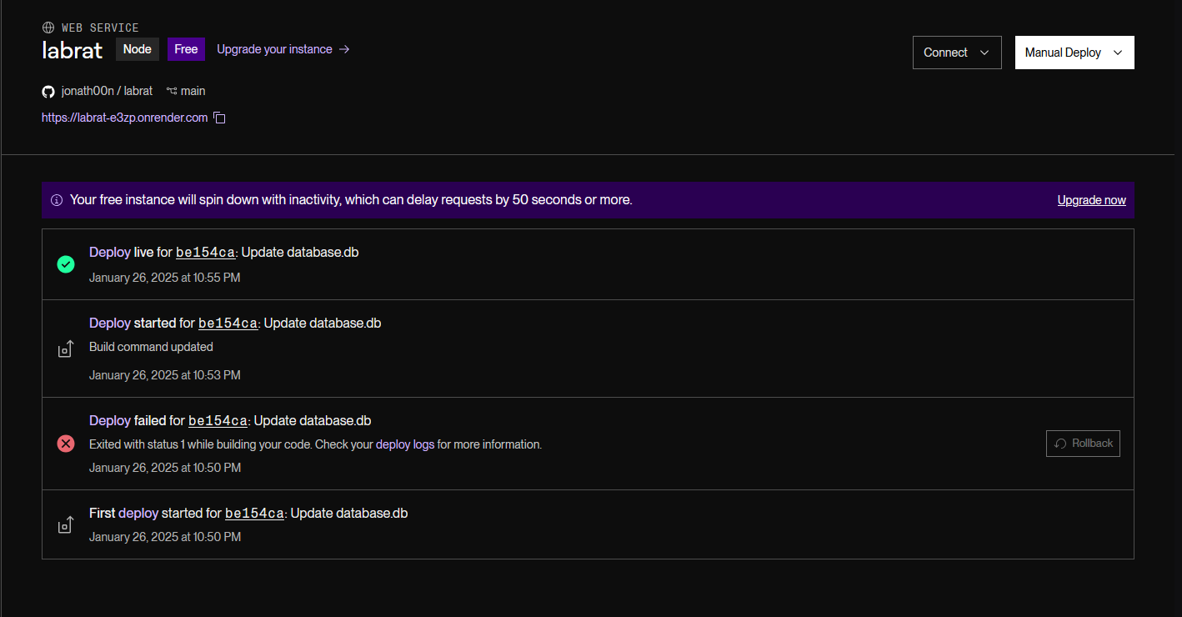
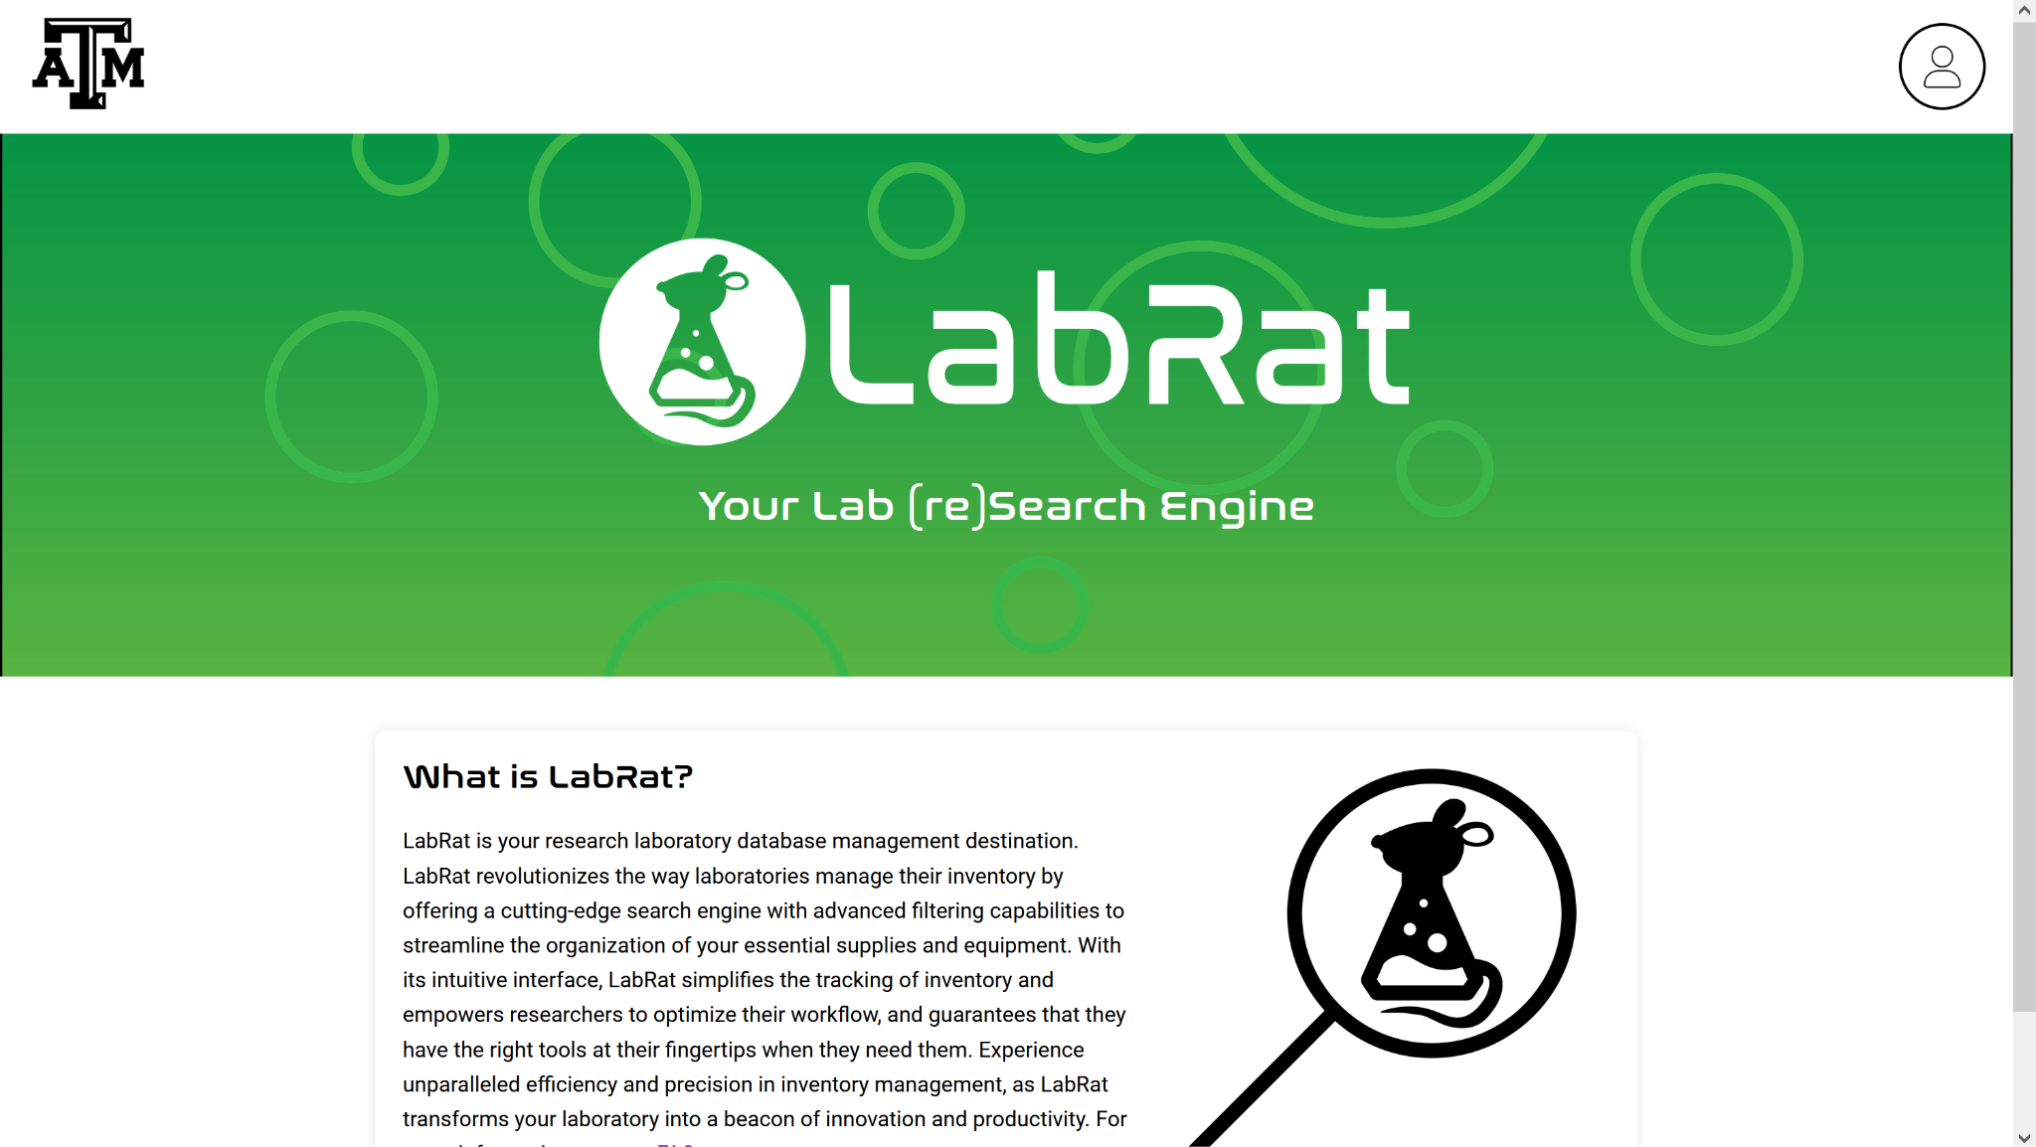
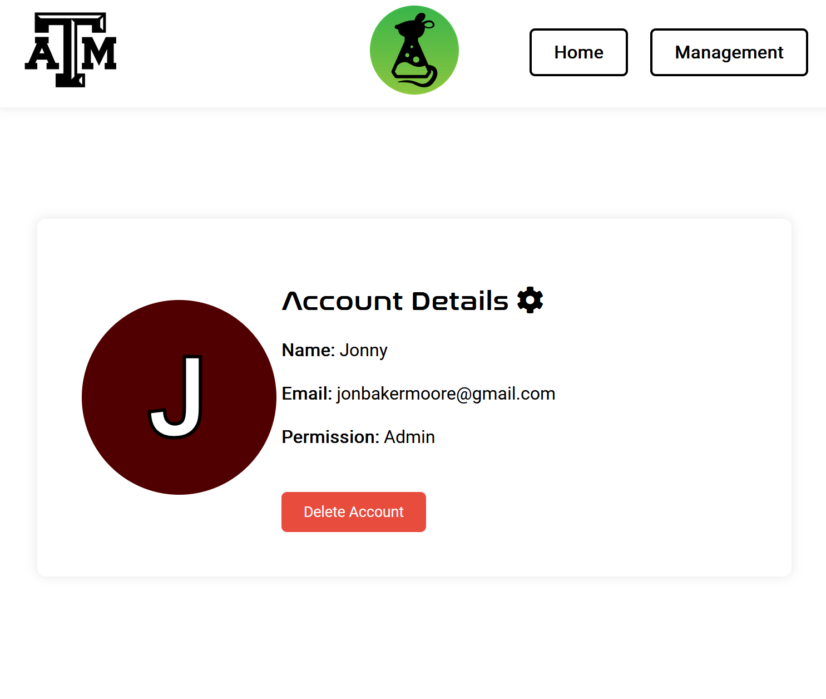
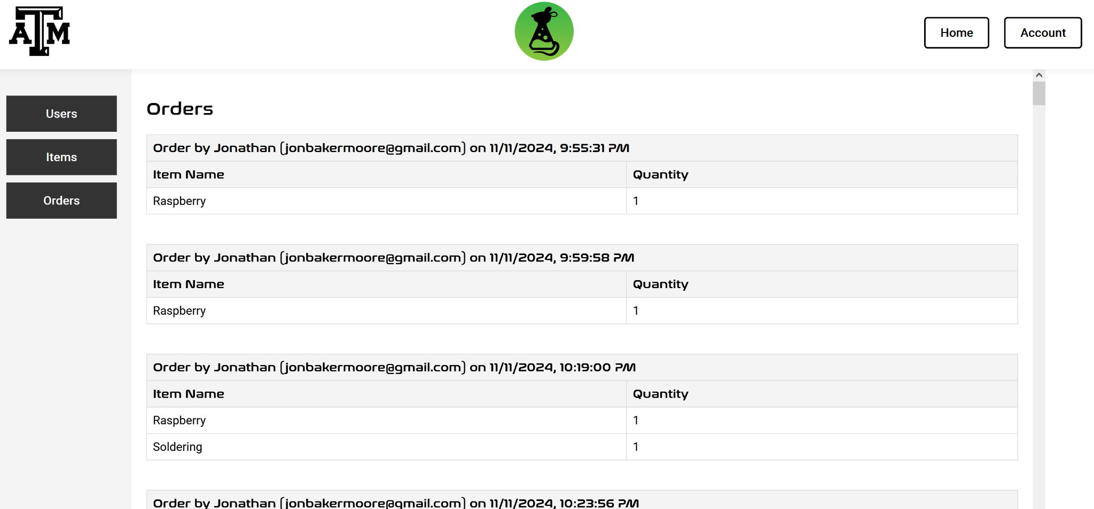
Website
Jonathan

Slide 10
Database Server
Lizzett
Accomplishments since last update 10 hrs of effort | Ongoing progress/problems and plans until the next presentation
Updated final database orders Python code needed for the website and app Completed AWS server integration preparation for both app and website | Will finalize what items the database will contain according to the machine learning model By next review will be integrated with website and mobile app
Notes:
-AWS integration prep: from app pov, can see the list of items from AWS database, rather than the local ones that got created in 403
- had to edit inbound rules through AWS server, which controls who can connect to the database

Slide 11
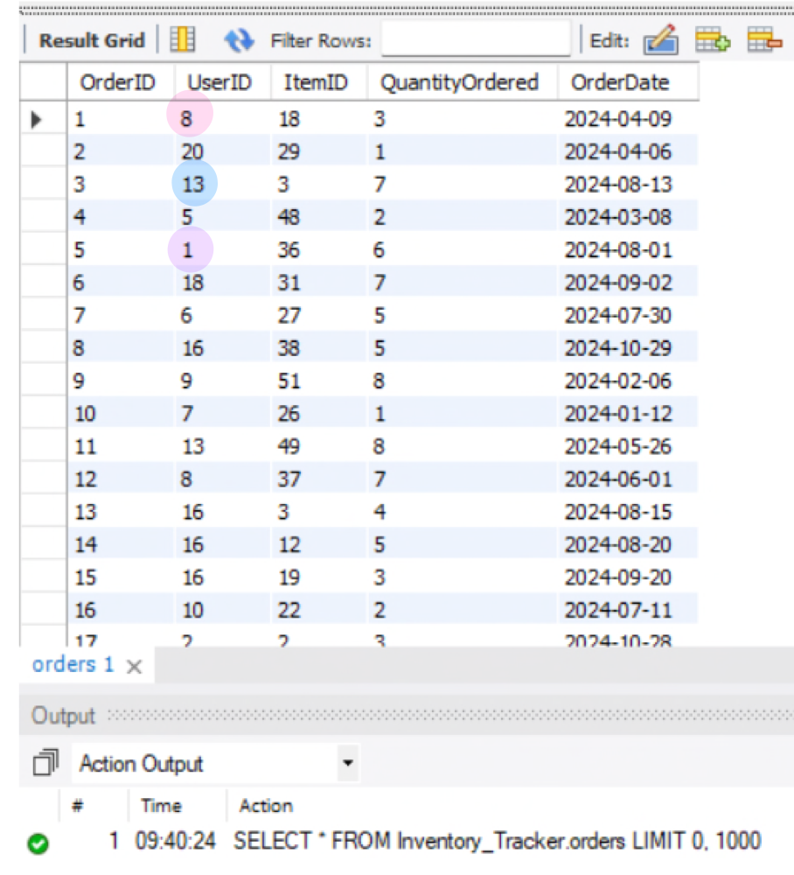
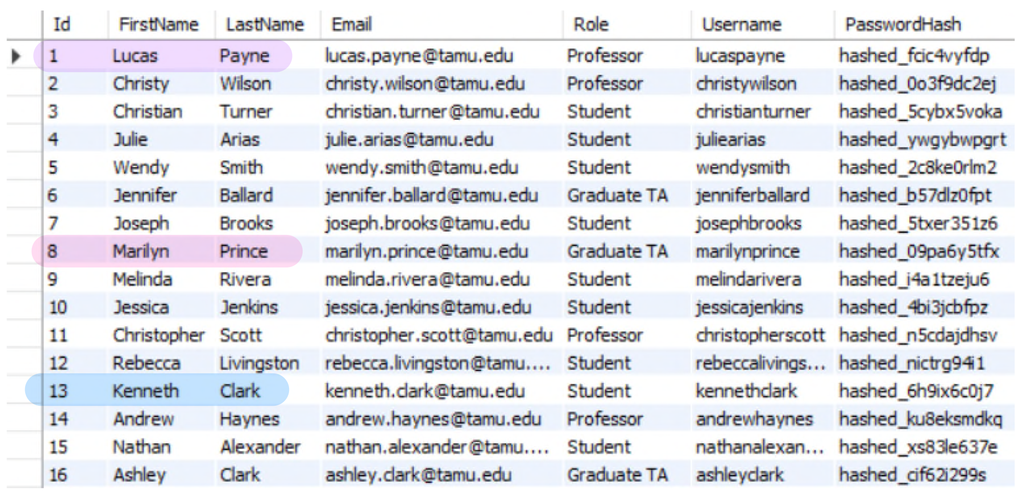
Database Server
Lizzett

Slide 12
Machine Learning Model
Sumedha
Accomplishments since last update 11 hrs of effort | Ongoing progress/problems and plans until the next presentation
Updated Datasets to match the Dataserver (as much as possible) Retrained model with new Datasets Saved model in .pth format (PyTorch) Uploaded to GitHub for integration with App | Wasn’t able to find datasets for a few classes for Server integration Ongoing integration with Mobile App Testing with App by next presentation

Slide 13
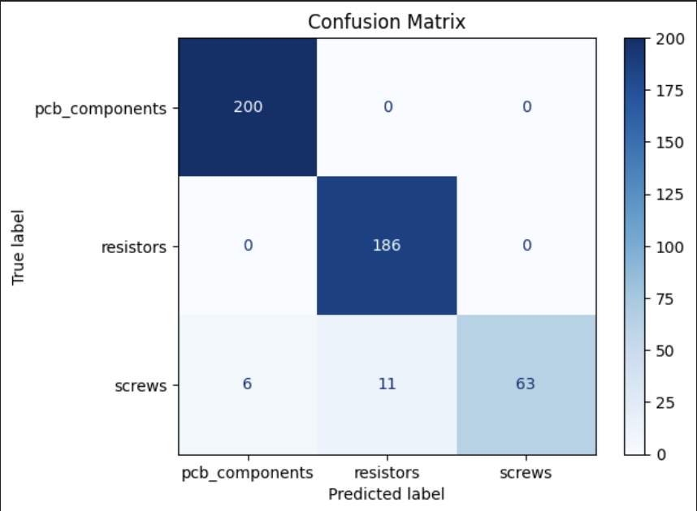
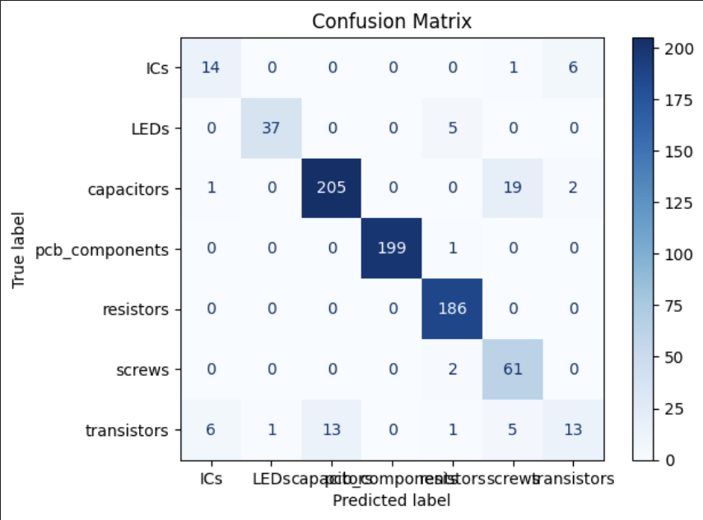
Machine Learning Model
Sumedha

Slide 14
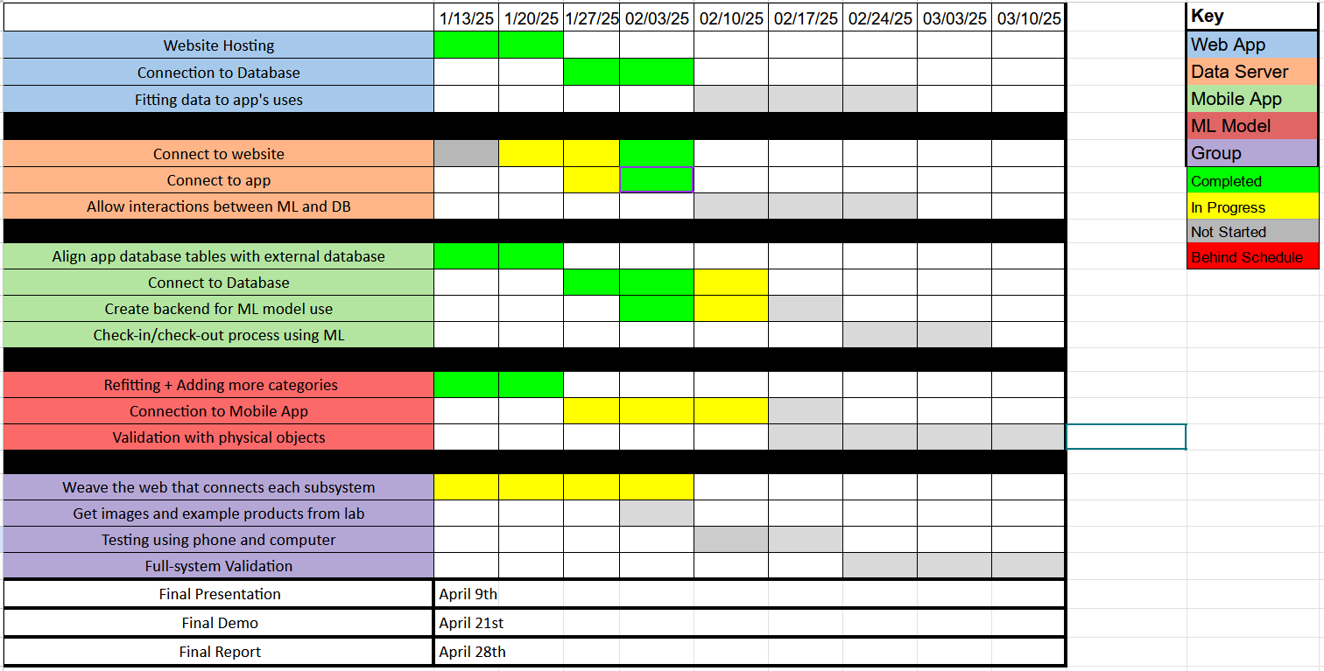
Execution Plan
Notes:
Michelle

Slide 15
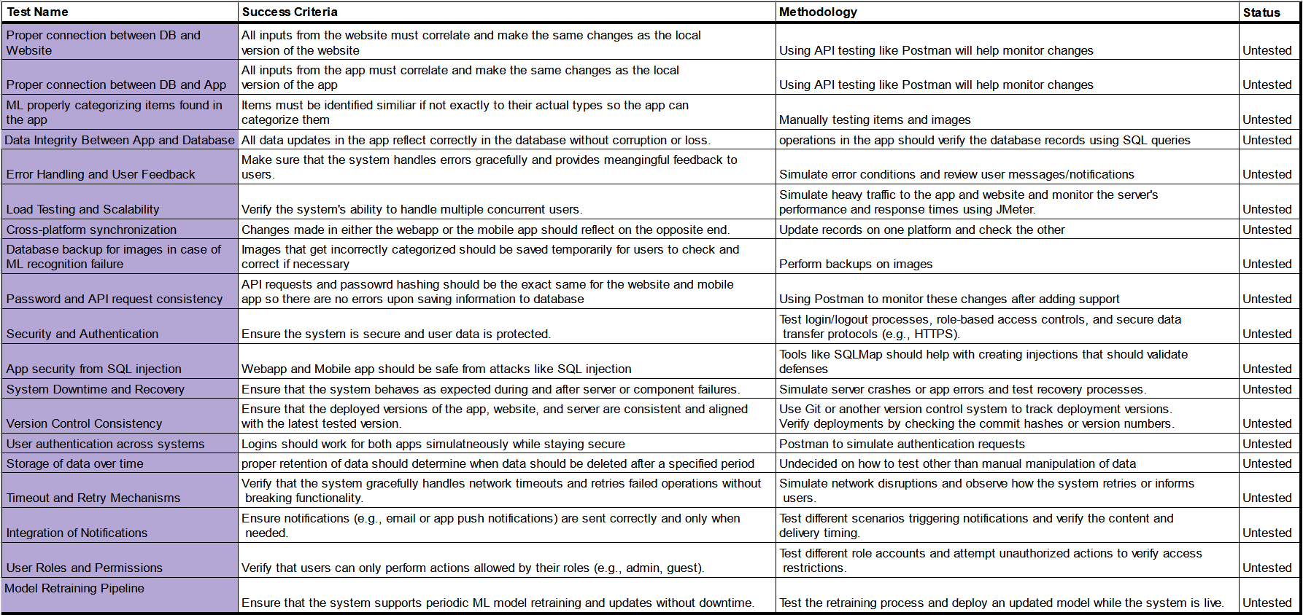
Validation Plan
Notes:
Michelle

Slide 16
Thank You For Listening!

